Slide 1
INSIGHTS INTO FORENSIC DNA SERVICES IN TANZANIA
Fidelis Charles Bugoye
Coordinator –National HDNA Database

Slide 2
Background
In Tanzania, DNA forensics is mainly performed at GCLA
What is GCLA?
Government Chemist Laboratory Authority
Established under German Colonial government in 1895
Started as the research center for Tropical Disease under Gustav Giemsa and Robert Koch
The institution went through various transformations until its establishment as an Authority in 2016 under GCLA Act , 2016

Slide 3
GCLA FUNCTIONS
GCLA functions are derived from the implementation of various Acts
GCLA Act-(2016)
HDNA Regulation Act-2009
Industrial & Consumers Chemicals Act – (2003)
From these Acts, GCLA is mandated to:
To process various samples including Forensic samples.
Expert witness
Establish National HDNA Database

Slide 4
Forensic DNA services
GCLA is the referral lab in Forensic DNA Services in Tanzania
Services provided includes:
Forensic DNA analysis
Disaster Victim Identification
Parentage DNA analysis
Sexual ambiguity analysis
Expert witnessing
HDNA regulatory services: Registration and inspection of HDNA laboratories
Establishment and Management of HDNA Database

Slide 5
General Work flow of Forensic DNA services in Tanzania

Slide 6
GCLA Capacity in Forensic DNA services
Legal mandate to offer forensic DNA services
(HDNA Act 2009 & GCLA Act 2016)
Adhere to ISO 17025:2017 accreditation requirements
Equipped with modern lab facilities
Well trained technical staff

Slide 7
Current situation

Slide 8
Human Identification in Mass disaster
GCLA has trained personnel and facilities to handle DVI:
10th August 2019 Morogoro Fuel Tank Explosion accident:
In August 2019, GCLA managed to identify 57 unidentified bodies
57 individuals were lost and 70
were seriously injured
More than 200 Buccal swab refence samples from relatives were collected to identify unknown bodies

Slide 9
Establishment of Tanzanian National HDNA Database(NHDNADB)
GCLA is legally mandated to establish and manage the NHDNA DB
Under section 59 (1)of the HDNA Act, 2009
Also under section 32 (1) of the GCLA Act , 2016

Slide 10
Why do we need NHDNADB?
-Family searching
-Allow fully utilization of DNA profiles in DVI cases
-Allow re-usability of generated DNA data for HID and Criminal investigation
-Reduce turn around time for DNA testing results
-Improve management of Tanzanian Genetic information

Slide 11
NHDNA Database Indices
Centralization and storage of HDNA Data

Slide 12
Forensic DNA Wildlife Services
Apart from Human DNA Forensics, GCLA is also mandated to receive and analyse Forensic DNA for Wildlife Cases
GCLA Act, 2016 under Sections 5(1) , 5(2)a and 20
The aim is to support investigation in Wildlife crime
Illegal taking, possession, trade, movement of animals and plants

Slide 13
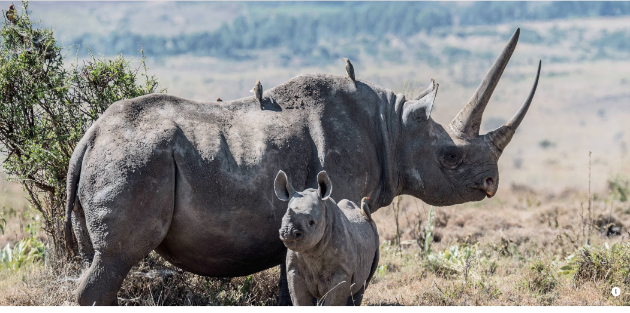
The capacity of GCLA in processing wildlife samples
Technical personnel
Established Mini wildlife DNA lab
Average number of samples (2021/22)- 60
Mostly are:
Tissue
Skeletal remains (bones and teeth)
Blood
Frequently seized samples (Ivory)
Photo credit :Geir Kiste

Slide 14
Challenges
DNA sequencing analysis
Bioinformatics application tools
Individualization techniques in Wildlife DNA
Working space due to increasing number of forensic samples
High running costs
Time lapse in acquiring reagents

Slide 15
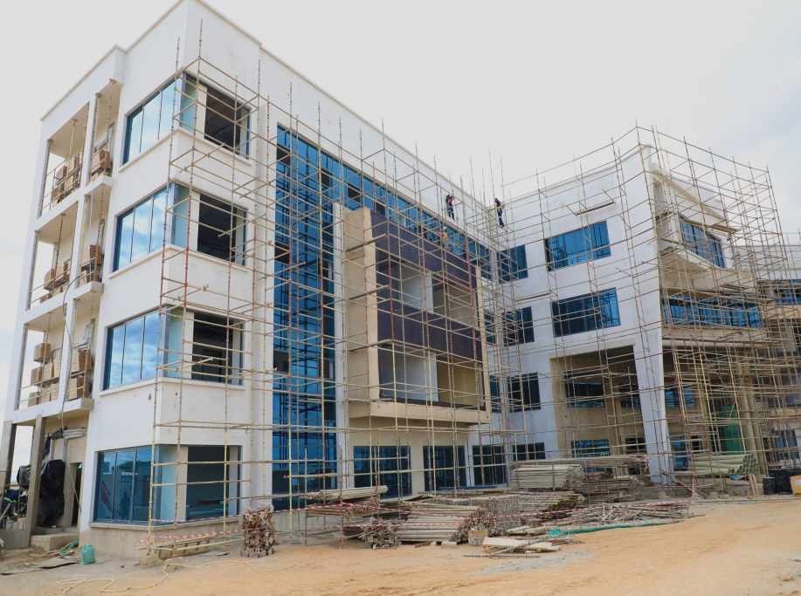
GCLA future plans
Expansion of the Forensic DNA services
Operationalizing the National HDNA Database
Increase staff training:
- DNA sequencing
- Bioinformatics applications
Acquiring more equipment and staff
Collaboration with other institution
Construction of GCLA Lab facilities in Dodoma-Tanzania

Slide 16
Thank you!!

